Slide 1


MoH leading the design and scale up of PrEP in eswatini
July 24, 2018
Sindy Matse
Ministry of Health

Slide 2


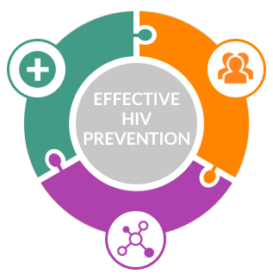

Why PrEP in eswatini?
New infections continue to occur in Eswatini despite major strides in the national response.
Annually, there are around 7,000¹ new HIV infections in Eswatini
When PrEP is used as part of a combination HIV prevention strategy to combat HIV, new infections can be greatly reduced.
¹https://phia.icap.columbia.edu/wp-content/uploads/2017/11/Swaziland_new.v8.pdf
Notes:
SHIMS 2 estimated 7,000 new infections per year.

Slide 3
PrEP eswatini chronology of Events
Nov 2016 Development & approval of National PrEP framework
Feb - Mar 2017 Approval and Submission of study protocols to SEC
Apr 2017 Development of IEC material and M&E tools
May – Sept 2017 Demonstration site trainings & preparation and PrEP sensitization and trainings of HCWs
August 2017 – Present Launch of all three study sites, monthly and quarterly meetings

Slide 4
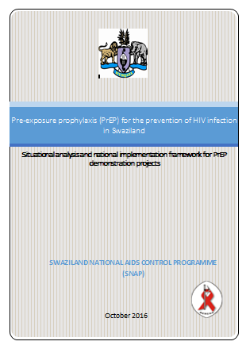
3 MoH led PrEP Demonstration projects in eswatini started in 2017 supported by partners
CHAI
MSF
FHI 360
Overall aim:
To assess the operationalization of PrEP in Eswatini as an additional HIV combination prevention method among population group and individuals at high risk of HIV infection
Key questions to be answered by studies:
  Acceptability
  Feasibility
  Cost effectiveness

Slide 5
PrEP Demonstration projects in eswatini
MSF | FHI 360 | CHAI
Women 16-25 yrs Pregnant and breastfeeding women MSM Sex workers (SW) HIV negative partner in SDC Clients with STI 794 clients | HIV negative people ≥ 18 who are identified, or identify, as at risk Support target demand creation for: - FSW - YW 18-25 - MSM - Males 1,300 clients | HIV negative people ≥16 who are identified at substantial risk through a risk assessment or HIV negative people who perceive themselves at high risk and/or request PrEP 538 clients
STUDY POPULATION
STUDY SIZE

Slide 6
PrEP Cascade across all MoH sites through june 2018
45% of clients at substantial risk for HIV infection initiated
96% of clients eligible initiated PrEP

Slide 7
Overall retention for all MoH sites through June 2018
56%
42%
31%
18%
Notes:
1) Preliminary data that has not been cleaned
2) Partners have not agreed on definition of retention, so the retention in regards to adherence/continuous use is being reported here. The total for each month’s follow up is then number of clients who were on PrEP and showed for that month’s follow up appointment. The percentage was calculated by taking the number of clients who attended the visit and dividing by the total number of clients who were expected to attend an appointment for that month out of those initiated.
3) Re-starts and STOPs have not been taken out of totals
4) Only 2 partners have clients who are eligible for Month 9 follow up visit at this time

Slide 8
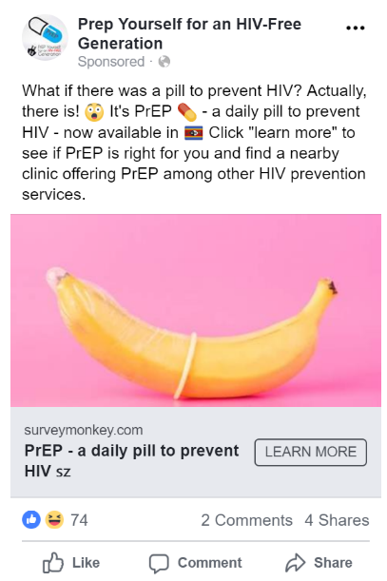
How is PrEP reaching KPs?
PrEP study site identification:
              FHI 360/LINKAGES identified all 5 study sites based on being in strategic locations to access KPs
              MSF identified one site specifically to support FSWs to access PrEP
KP integrated training materials:
              Including “Working with Different Groups” module as part of the MoH Health Care Workers PrEP training
Community-based demand creation
              Supported a 5 day training on PrEP Demand Creation for CSOs through ITPC
              Capacity building of community-based KP peer educators on PrEP
              Facebook: the MoH page “PrEP Yourself for an HIV-Free Generation” includes ads targeting MSM, SW, individuals with LGBT interests, and AGYW
              Community to clinic referrals from KPs for KPs

Slide 9
Are Key Populations Accessing PrEP?
Problem identified: Unable to determine if KPs were accessing PrEP.
Approach: Assign PrEP nurse mentors to the LINKAGES clinical outreach services to counsel and discuss PrEP with interested KPs.
Results: Conducted 6 PrEP-focused outreaches in June, provided 40 referrals to preferred clinics. As of June 30th, 10 completed the referrals, of which 3 disclosed their KP status at the clinic.
Key observation: Only 30% of those clients interested in accessing PrEP disclosed their KP status at the clinic.

Slide 10
MSM and FSWs and PrEP – What is happening?
“I would like if there KP CBOs were also providing PrEP as some of the people they refer never get to the facilities or when they happen to go, they never say anything about their sexuality yet they are open in the CBOs”– MSM from Eswatini
“I started PrEP because I was encouraged by an Outreach Worker and I thought I needed it because sometimes I have unprotected sex with men.” – FSW from Eswatini
“I think it should be encouraged to young girls before they are even exposed to HIV. Most girls are exposed after engaging in sex work so PrEP should target them as soon as possible.”- FSW from Eswatini
PrEP is the best intervention we've had so far. – MSM from Eswatini

Slide 11
Lessons learned & next steps
Lessons learned:
          Allow the use of different service delivery points within facilities targeting different populations groups to reduce stigma and discrimination for certain populations
          Still hesitancy for HCWs treating KPs at clinics
          Unable to document KPs accessing PrEP as disclosure at the clinic is a challenge
Next steps:
          Develop a communication strategy for community mobilization to be used by all partners – focus demand creation at the community level for target populations
          Conduct initial PrEP screening at mobile via completion of part A of MoH PrEP Risk Assessment and Eligibility Screening Form

Slide 12




Acknowledgements
Thank you
Health care workers from participating PrEP sites, Regional partners, community members and stakeholders

